Slide 1
KGISL Micro college
Name : UDHAYA KUMAR P
Roll No : RWD 1006
UBER EATS
Project
Using HTML5 and CSS and Bootstrap and
and Java script..

Slide 2
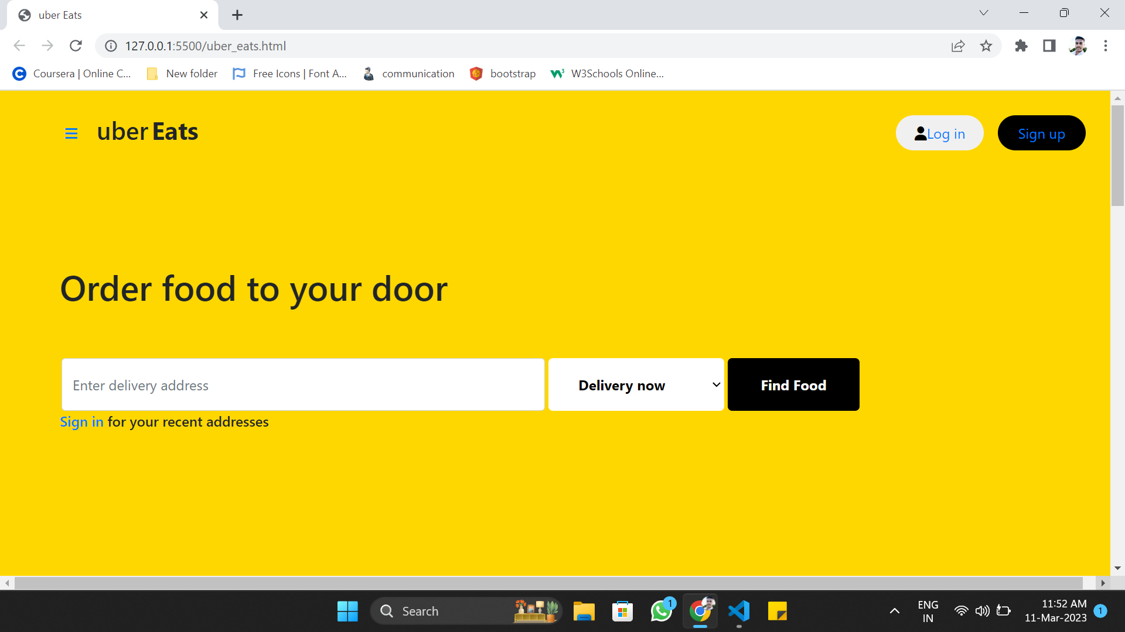
Desktop view – Front page

Slide 3
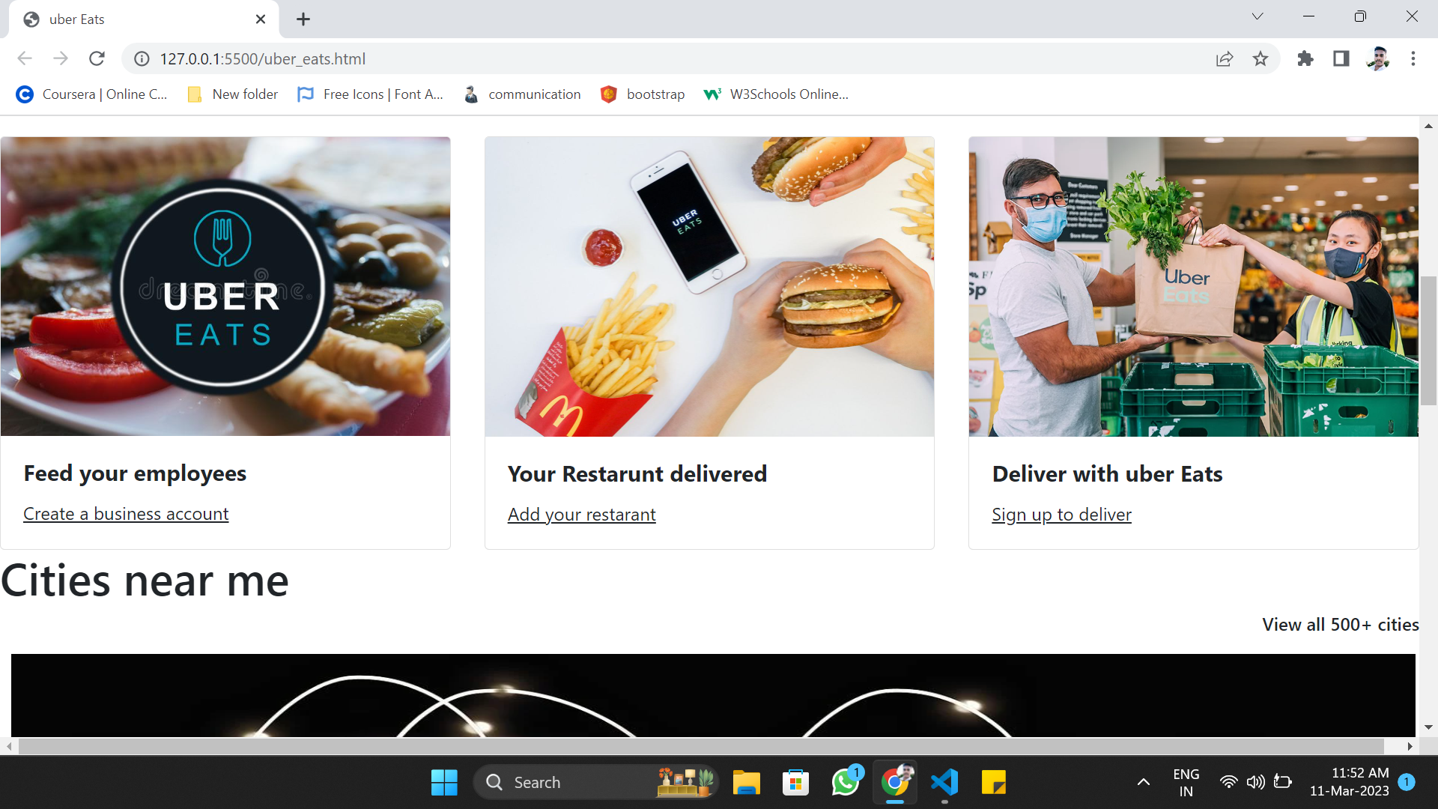
Desktop view – Body page

Slide 4
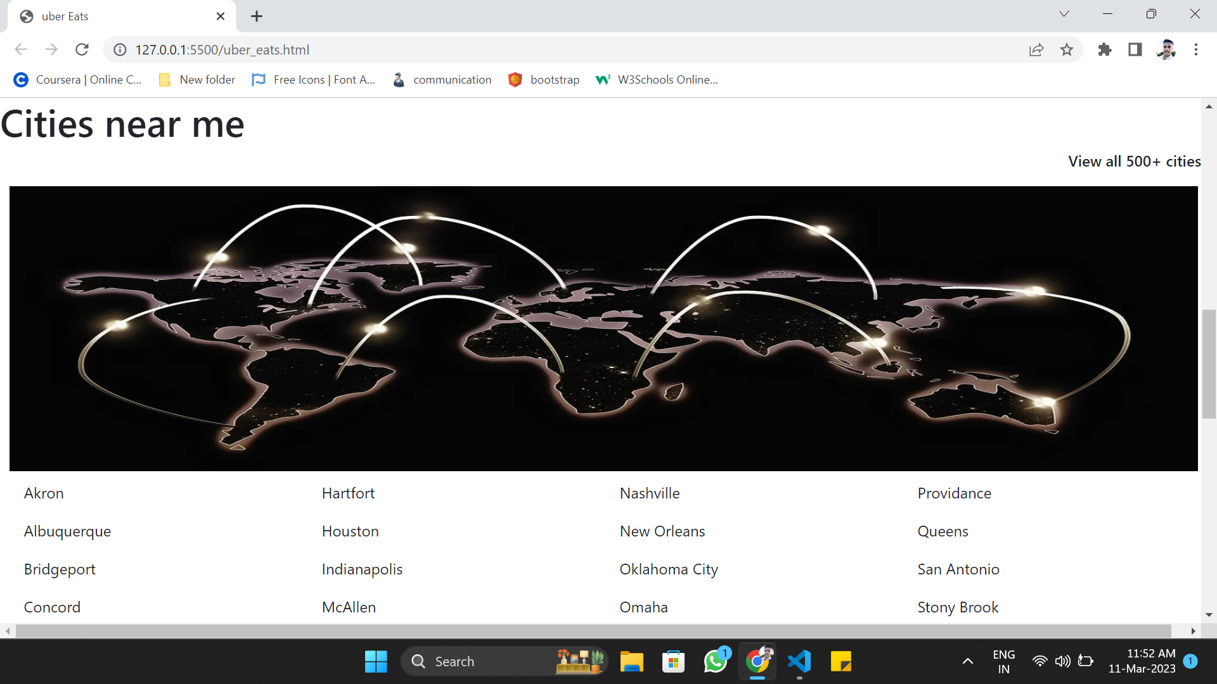
Desktop view – Body page

Slide 5
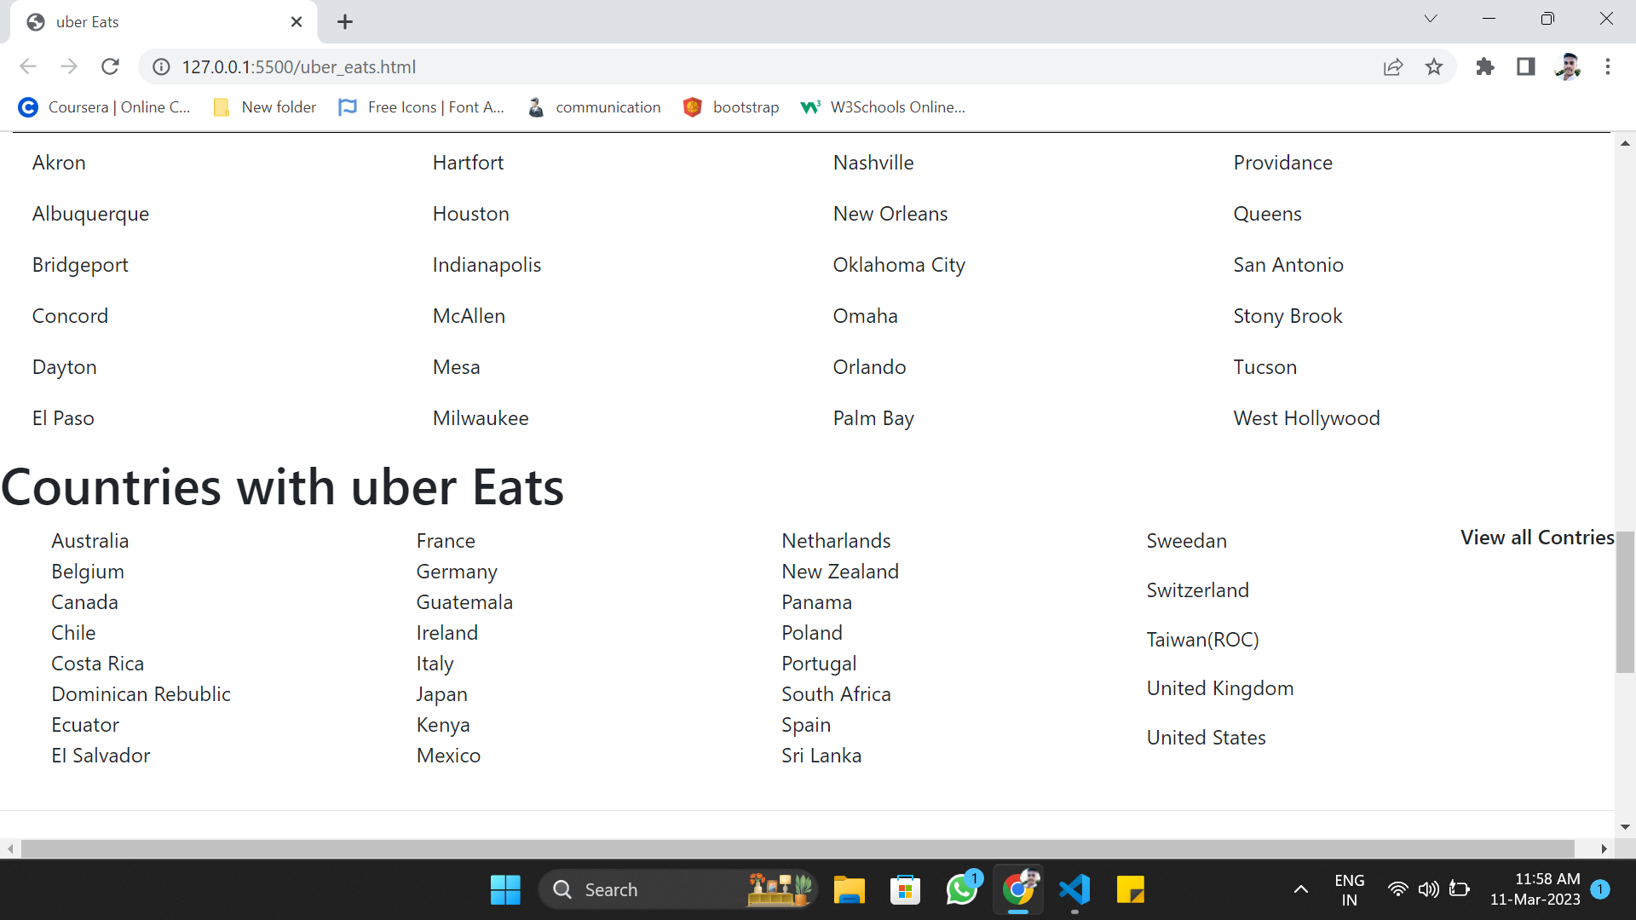
Desktop view – Body page

Slide 6
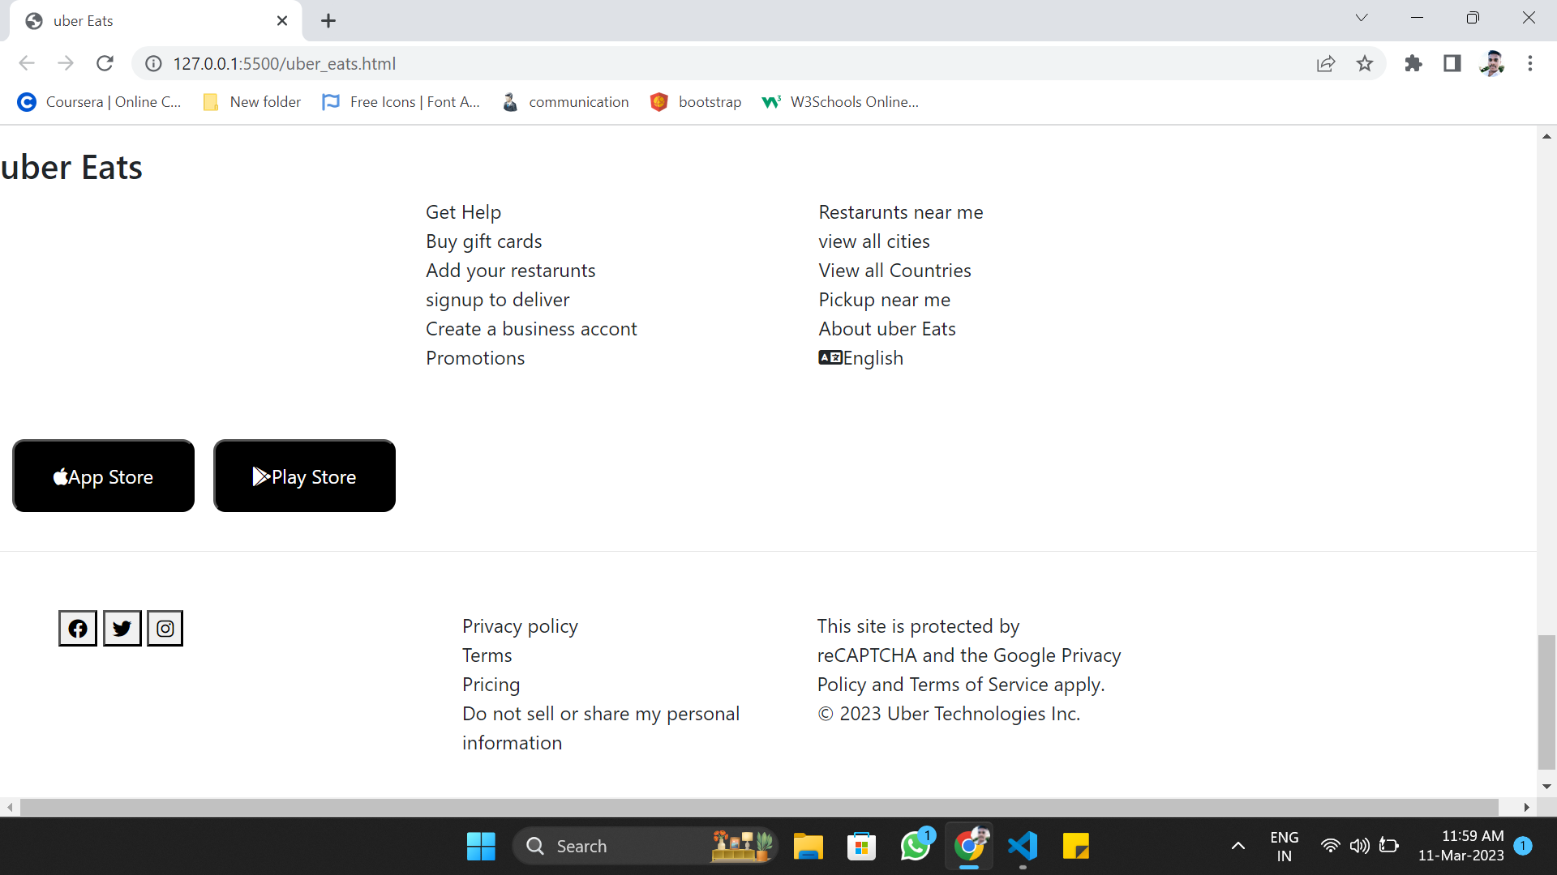
Desktop view – Footer page

Slide 7
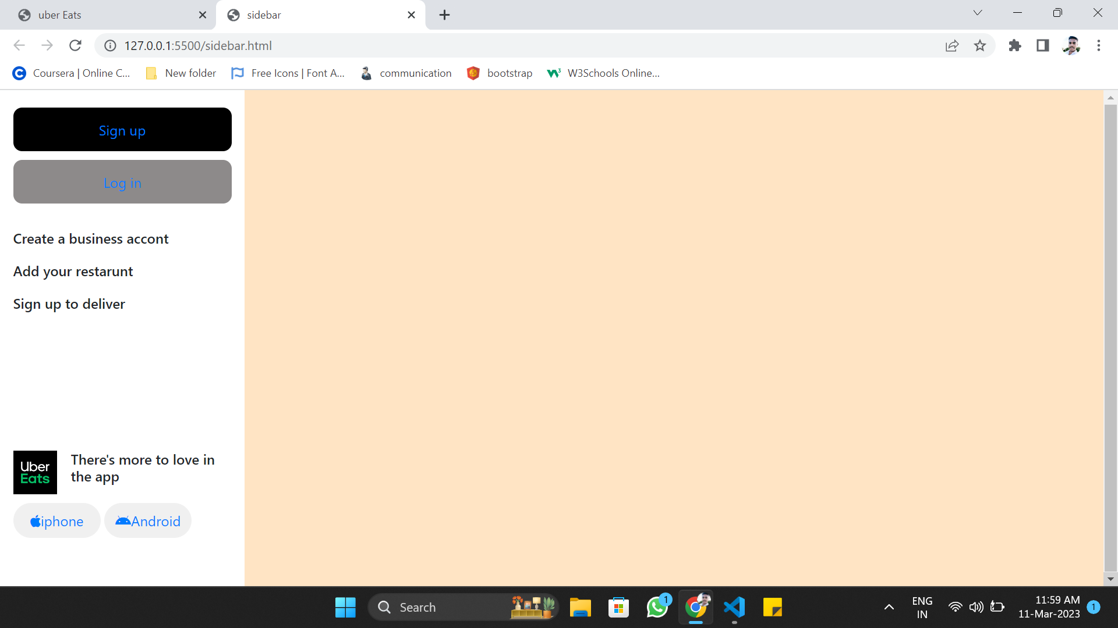
Desktop view – Vertical Side Navigation Bar

Slide 8
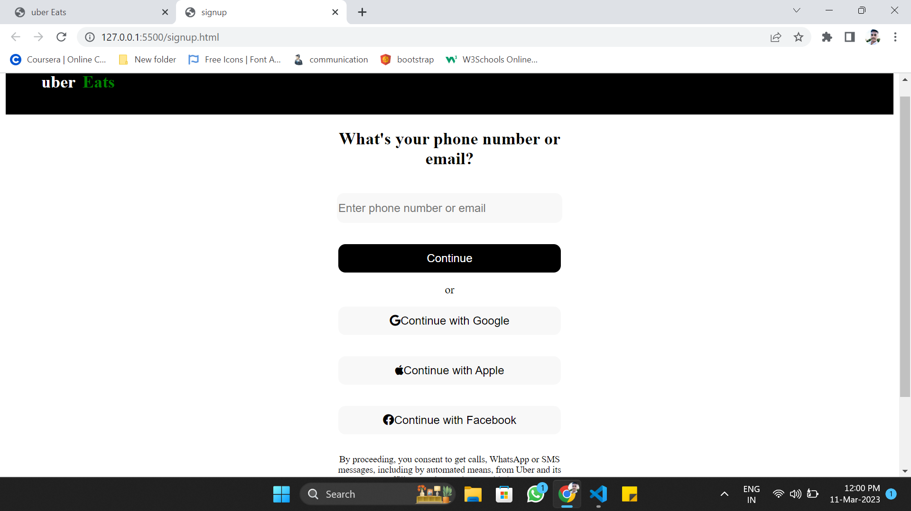
Desktop view – Login page

Slide 9
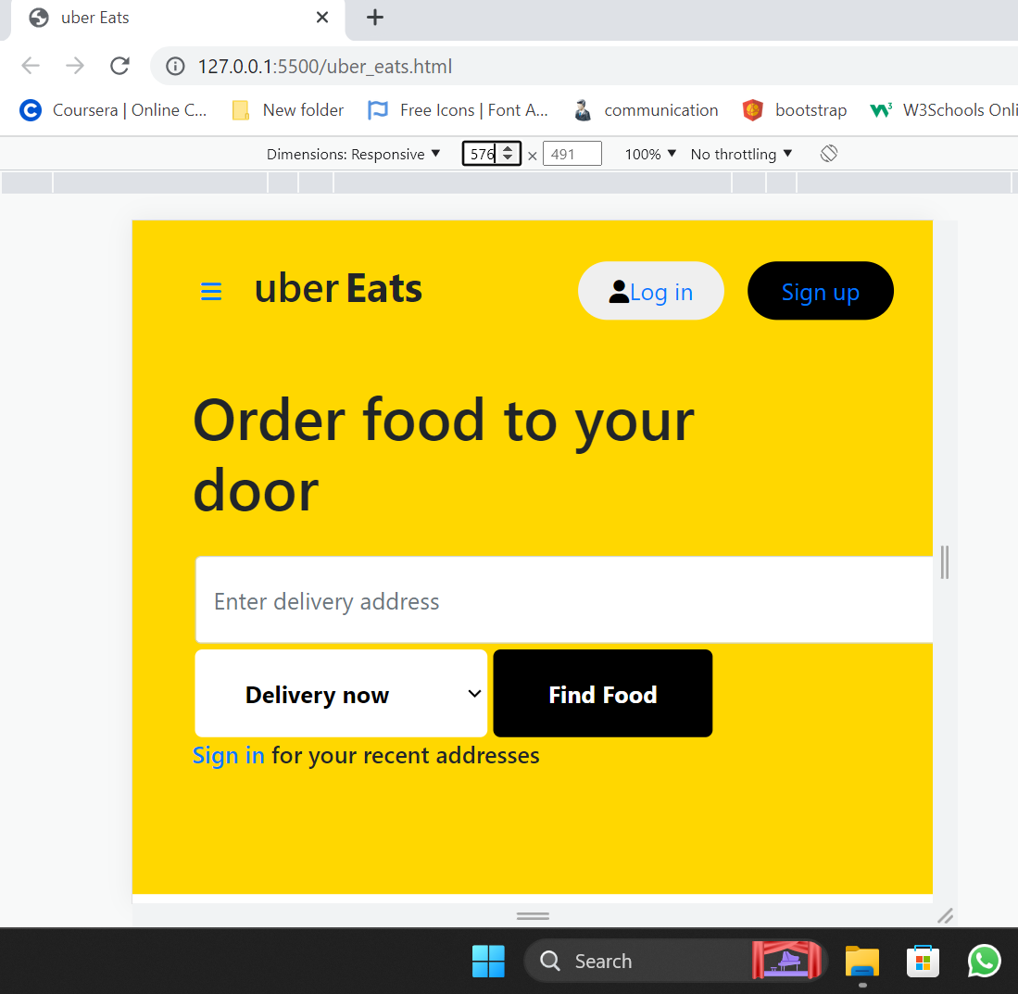
Mobile view Front Page

Slide 10
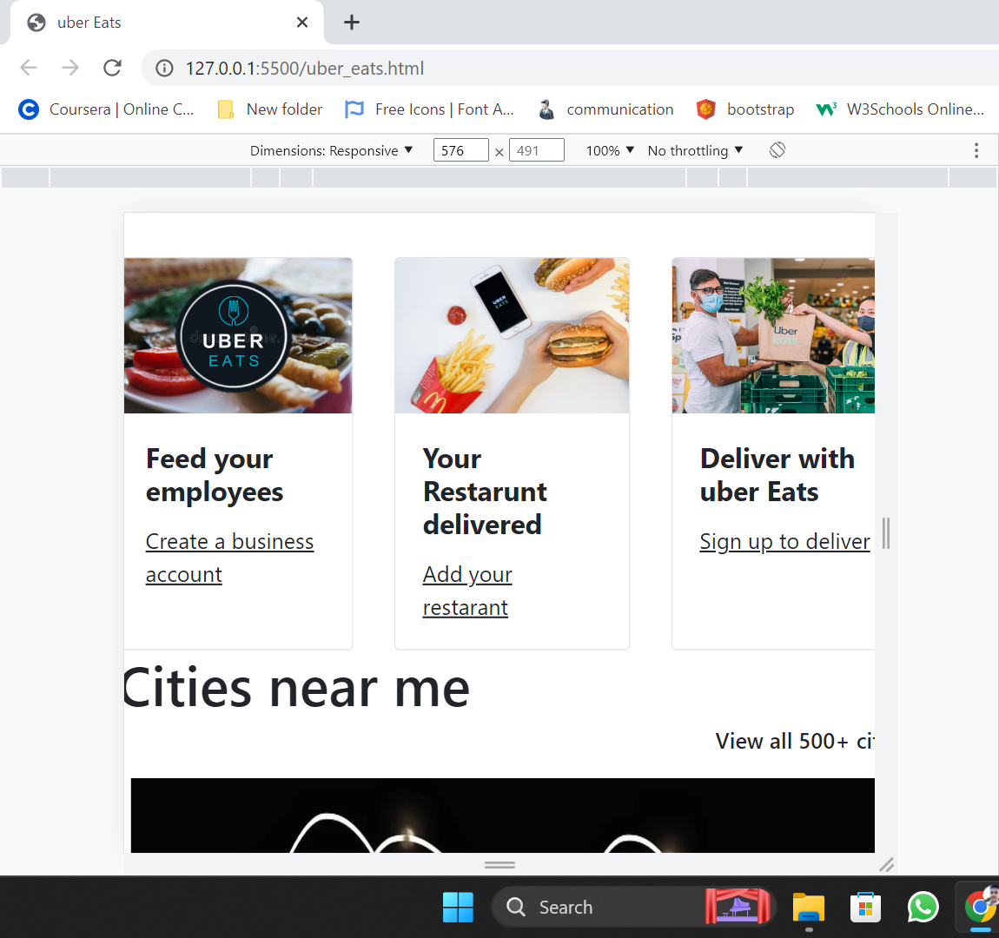
Mobile view Body Page

Slide 11
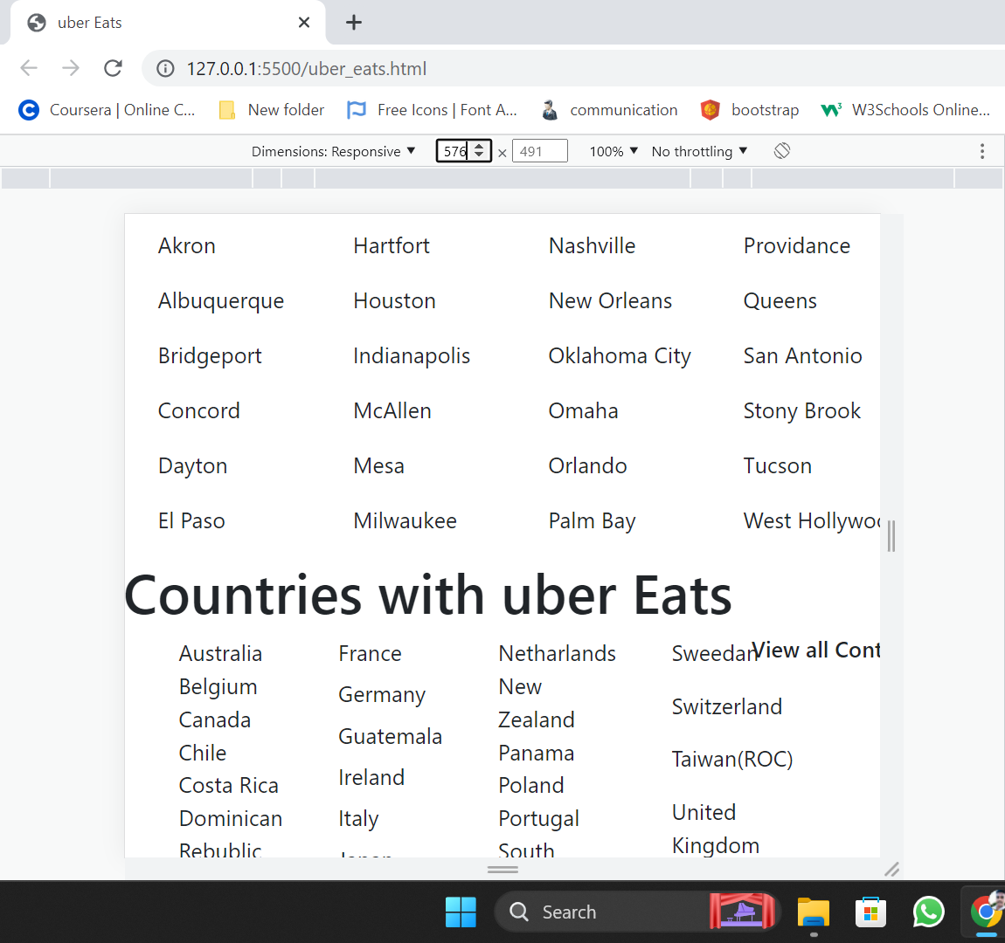
Mobile view Body page

Slide 12
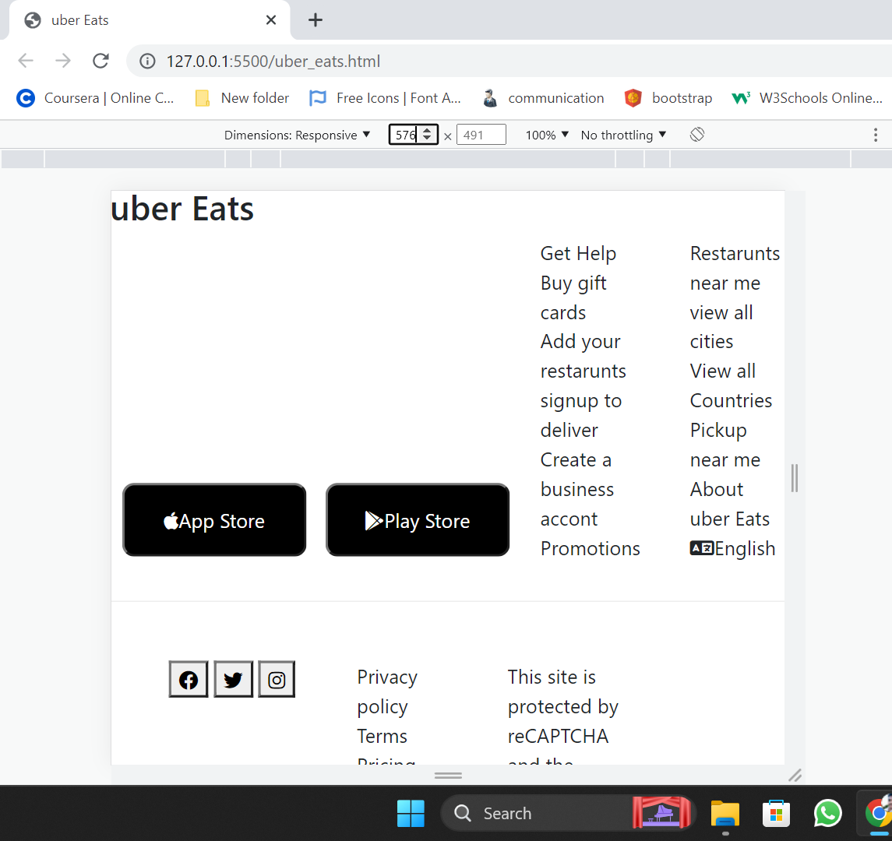
Mobile view Footer Page

Slide 13
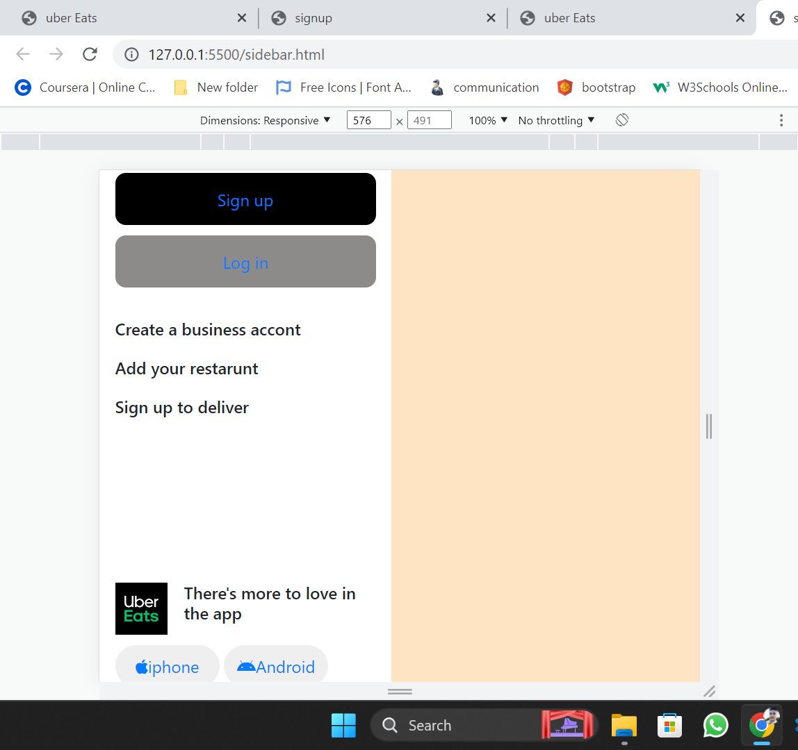
Mobile view Vertical Navigation Bar

